Slide 1
The Reference Section:
Remarks by Bill Collins Former Director of the Bahá’í World Centre Library, CHIEF OF COPYRIGHT CATALOGING DIVISION AND PLANNING OFFICER AT THE LIBRARY OF CONGRESS
23 April 2022

Slide 2
International Bahá’í Library – The Future
The International Baha'i Library. This Library is the central depository of all literature published on the Faith, and is an essential source of information for the institutions of the World Center on all subjects relating to the Cause of God and the conditions of mankind. In future decades its functions must grow, it will serve as an active center for knowledge in all fields, and it will become the kernel of great institutions of scientific investigation and discovery.
(Universal House of Justice, Messages from the Universal House of Justice 1986-2001, 36.4e)

Slide 3
Place of the Library & Archives
“... [the Haẓíratu’l-Quds]... will, as its component parts, such as... the Archives [and] the Library... are brought together and made jointly to operate in one spot, be increasingly regarded as the focus of all Bahá'í administrative activity, and symbolize, in a befitting manner, the ideal of service animating the Bahá'í community in its relation alike to the Faith and to mankind in general.”
(Shoghi Effendi, God Passes By, p. 339)

Slide 4
World Association to Promote Bahá’í Libraries & Archives (WABLA)
Proposed @ 1st Int’l Conference of Bahá’í Librarians & Archivists (Landegg University, January 2003)
Initial Board of Directors: Bill Collins, Ailsa Hedley Leftwich, Dharlene Valeda
Organizational attempts proved abortive
Limited ongoing interest
Changed staffing at Bahá’í libraries/archives, often untrained volunteers asking broad questions: “How do I catalogue the library collection?” and “How do I classify books?”

Slide 5
Bahá’í Library & Archives Website
Bill created website with aids & info related to various aspects of Bahá’í library and archives work; reconstituted in a different form in July 2019 after a gathering of Bahá’í book collectors
Not intended as a site for aggregating Bahá’í texts, but as a site focused on the toolkit for library and archives workers serving in Bahá’í-related institutions or collections.
https://bahailibraryandarchives.org
Needs suggestions of improvements to serve the needs of Bahá’í librarians and archivists.
Facebook: https://www.facebook.com/groups/115764608458956

Slide 6
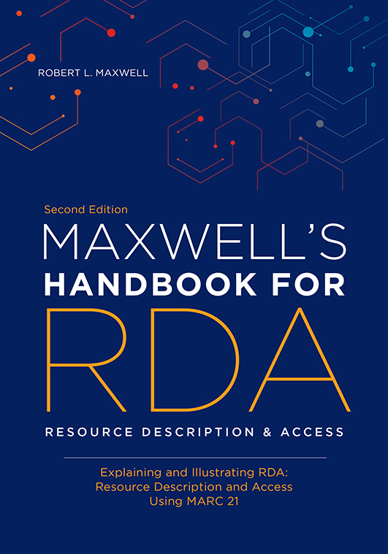
Professional Training & Standards
Staff of Bahá’í libraries/archives need training and understanding of standards (http://coursecatalog.syr.edu/preview_program.php?catoid=29&poid=14955&returnto=3699)
Policies and ethical standards are essential for managing and preserving records & publications
Standards of description and classification: e.g., RDA (Resource Description and Access), classification systems (there are several)
Indexing methods and vocabularies (controlled subjects, tags, text)
Catalogues and finding aids: Merging of internal/external records; physical and digital resources

Slide 7
Bibliographic Resources (1)
Bibliography and database
Manually entered records from Bibliography of English Language Works on the Bábí and Bahá’í Faiths, 1844-1986 (1990) first into a ProCite database, then converted to EndNote.
29,000+ records, including analytical records of chapters and articles.
Curated: i.e., includes items seen or received from a trusted source of data
Digital pdf attachments are also included.
Incomplete. Not publicly available.
Steve Cooney database of references needs to be compared and checked.

Slide 8
Bibliographic Resources (2)
Association for Bahá’í Studies
Exploring creation of topical annotated bibliographies from reliable sources.
Step toward something more comprehensive, perhaps making a bibliography available online
Issues about the abstracts/annotations and the inclusion of published works by Covenant-Breakers, enemies, and mentally unstable individuals.
Bahai-library
Exploring an online consolidated bibliographic database

Slide 9
Sustaining Bibliographic and Aggregating Efforts into the Future
How can the bibliographic (Collins, Cooney) efforts be extended into the future beyond the individuals?
How can the aggregation (https://bahai-library.com, https://bahai.works, https://bahaiarc.org) efforts be extended into the future?

Slide 10
University & Research Library CollectionS: Recommending Bahá’í Materials
How do we create a recommending task force that establishes relationships with selected institutions to offer ongoing recommendations of materials to collect, based on those libraries’ acquisitions policies?
How to build Bahá’í collections in academic libraries and archives
Individuals have donated to academic institutions (Otto Donald Rogers at U. Regina; Will van den Hoonaard at U. New Brunswick; Jack & Arden Lee at Stanford)
Endowed positions and collections in libraries and archives
Bill has been the Bahá’í recommender for the Library of Congress for three decades. How do we place knowledgeable Bahá’ís in positions where they are bringing to the attention of acquisitions librarians the best and most useful Bahá’í materials?
Correcting errors in library cataloguing records

Slide 11
Encouraging Donations
Anyone who, spontaneously and of his own free will, donates material to the Archives of his National Spiritual Assembly - whether this be Tablets, books, pictures, objects or the like - and especially if his inheritors are not accounted of the people of Bahá, or are not considered by him as trustworthy or reliable, will have performed a highly meritorious act in the sight of God, and his name will be perpetuated in the records of the Spiritual Assemblies and his memory enshrined in the Archives for ever.
Letter of Shoghi Effendi, July 1925 to the Bahá’ís of the East

Slide 12
issues summarized
Current role for WABLA.
Improvements to the librarians and archivists website.
Training for Bahá’►1s working in Bahá’í libraries and archives
Sustaining individual bibliographic and aggregating efforts in the future.
Online, updateable, accessible bibliographic database; Published bibliographies
Task force to recommend reliable Bahá’í-related resources to libraries; submit corrections for erroneous records.
Encourage gifts to Bahá’í libraries and archives; academic libraries

