Slide 1
The Verge of the New
Dr. Steven Phelps
Norwegian BahÁ’Í Summer School, july 2017

Slide 2
Day 1

Slide 4
Forces of light and darkness?

Slide 5
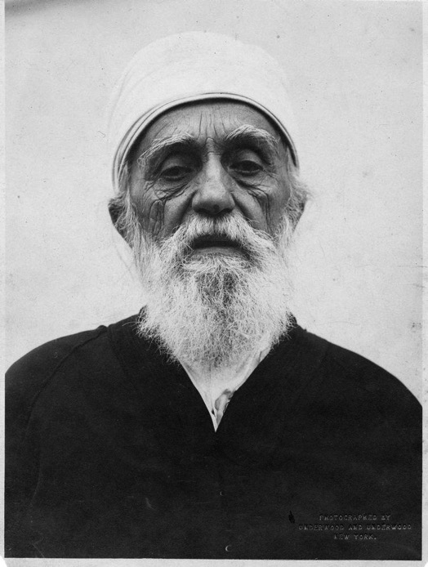
Century of light…
“In cycles gone by, though harmony was established, yet, owing to the absence of means, the unity of all mankind could not have been achieved… In this day, however, means of communication have multiplied, and the five continents of the earth have virtually merged into one…. For none is self-sufficiency any longer possible, inasmuch as political ties unite all peoples and nations, and the bonds of trade and industry, of agriculture and education, are being strengthened every day. Hence the unity of all mankind can in this day be achieved. Verily this is none other but one of the wonders of this wondrous age, this glorious century. Of this past ages have been deprived, for this century—the century of light—hath been endowed with unique and unprecedented glory, power and illumination.”
(Selections from the Writings of Abdu'l-Bahá, #15)
'Abdu'l-Bahá
(1844-1921)

Slide 6
…or Century of darkness
“Chaos and confusion are daily increasing in the world. They will attain such intensity as to render the frame of mankind unable to bear them. Then will men be awakened and become aware that religion is the impregnable stronghold and the manifest light of the world, and its laws, exhortations and teachings the source of life on earth.” (Abdu'l-Bahá, The Compilation of Compilations #1587 )
'Abdu'l-Bahá
(1844-1921)

Slide 7
“The world is in travail, and its agitation waxeth day by day. Its face is turned towards waywardness and unbelief. Such shall be its plight, that to disclose it now would not be meet and seemly. Its perversity will long continue. And when the appointed hour is come, there shall suddenly appear that which shall cause the limbs of mankind to quake. Then, and only then, will the Divine Standard be unfurled, and the Nightingale of Paradise warble its melody.”
(Gleanings #61)
Bahá’u’lláh
(1817-1892)

Slide 8
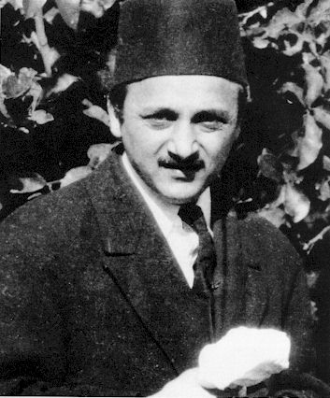
“Adversity, prolonged, worldwide, afflictive, allied to chaos and universal destruction, must needs convulse the nations, stir the conscience of the world, disillusion the masses, precipitate a radical change in the very conception of society, and coalesce ultimately the disjointed, the bleeding limbs of mankind into one body, single, organically united, and indivisible.”
(The Promised Day Is Come, p.122-123)
Shoghi Effendi
(1897-1957)

Slide 9
“It seems what we need now is a more profound and co-ordinated Bahá'í scholarship in order to attract such men as you are contacting. The world has -- at least the thinking world -- caught up by now with all the great and universal principles enunciated by Bahá'u'lláh over 70 years ago, and so of course it does not sound "new" to them. But we know that the deeper teachings, the capacity of His projected World Order to re-create society, are new and dynamic. It is these we must learn to present intelligently and enticingly to such men!”
(Letter dated 3 July 1949)
Shoghi Effendi
(1897-1957)

Slide 10
What are the deeper teachings?
Unity of God?
Unity of humanity?
Elimination of racial prejudice?
Equality of the sexes?
Social justice?
Service to others?
Loving one’s enemies?

Slide 11
Plan for the week
Day 1
The context of the present moment
Modern physics
Day 2
Limits of language
God, spirit, nature
Day 3
The Prophet and Divine Revelation
Day 4
Religion redefined

Slide 12
“All we can reasonably venture to attempt is to strive to obtain a glimpse of the first streaks of the promised Dawn that must, in the fullness of time, chase away the gloom that has encircled humanity.”
(The World Order of Baha’u’llah, p. 35)
Shoghi Effendi
(1897-1957)

Slide 13
Zoom out!

Slide 14
Leap #1: Abstract thought

Slide 15
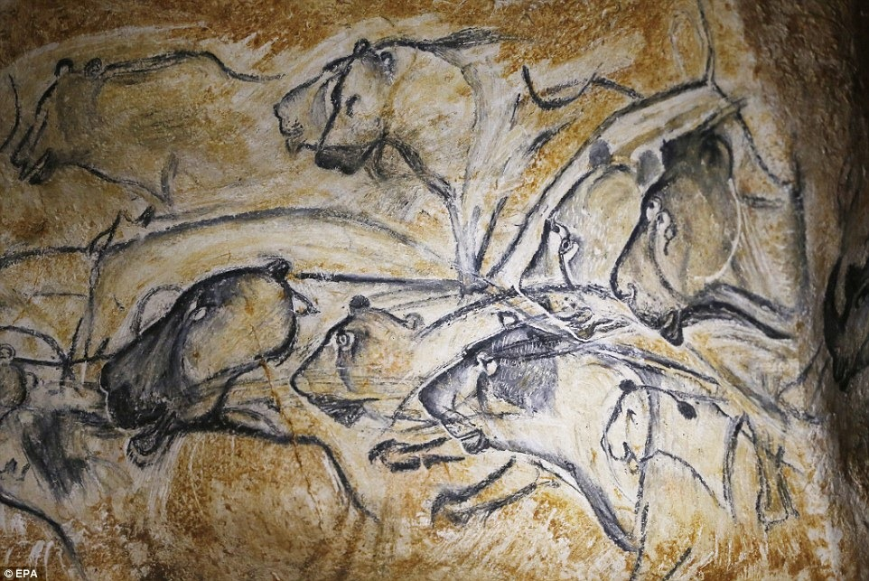

Slide 16
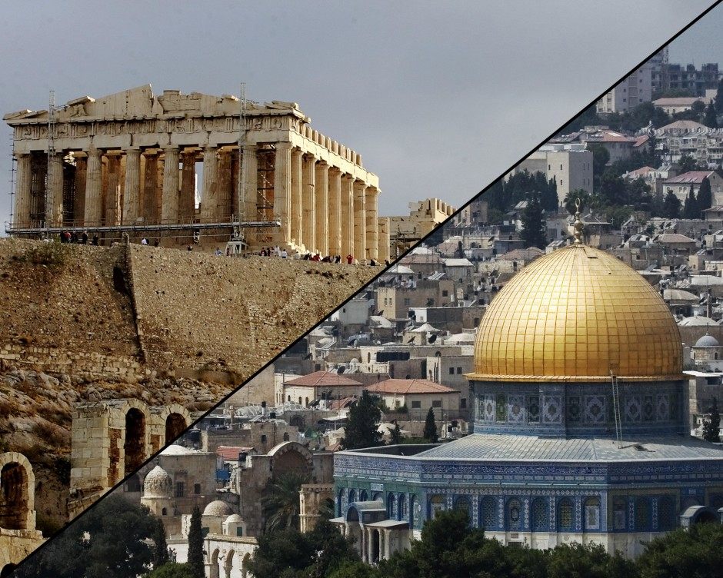
Leap #2: The axial age (800-300 B.C.)

Slide 17
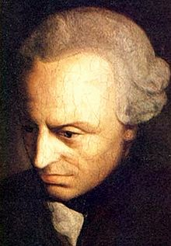
Leap #3: The “Greater Enlightenment”
“What is enlightenment?
Enlightenment is man’s emergence from his self-imposed immaturity. Immaturity is the inability to use one’s understanding without guidance from another…
Dare to know! Have courage to use your own understanding! – that is the motto of enlightenment.”
Emmanuel Kant
(1724-1804)

Slide 18
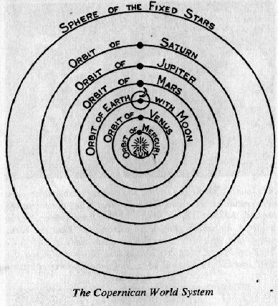
Stages of the “Greater Enlightenment”
1. Scientific (Copernicus)
2. Philosophical (Kant)
3. Religious (the Báb
and Bahá’u’lláh)
Overarching theme? Displacement
from the Center

Slide 19
Pillars in the edifice of modern physics
I. Relativity
IV. Complementarity
II. and III. Symmetry and Invariance
Notes:
I. II. http://ffden-2.phys.uaf.edu/webproj/212_spring_2014/Abdel_Abouhaib/101559128653564b3256663/wave-particle-duality.html III.

Slide 20
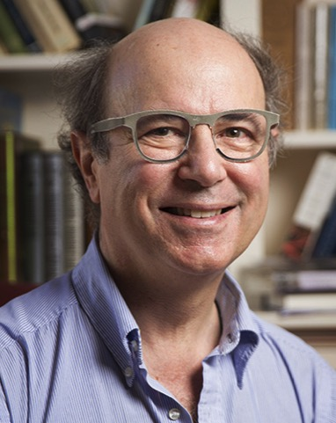
“These big ideas—relativity, symmetry, invariance, complementarity—form the heart of modern physics. They should be, though they are not yet, central to modern philosophy and religion.”
(A Beautiful Question, p. 75)
Frank Wilczek,
Nobel Laureate
(1951- )

Slide 21
Pillars in the edifice of the Baha’i Revelation
I. Relativity
IV. Complementarity
II. and III. Symmetry and Invariance
Notes:
I. II. http://ffden-2.phys.uaf.edu/webproj/212_spring_2014/Abdel_Abouhaib/101559128653564b3256663/wave-particle-duality.html III.

Slide 22
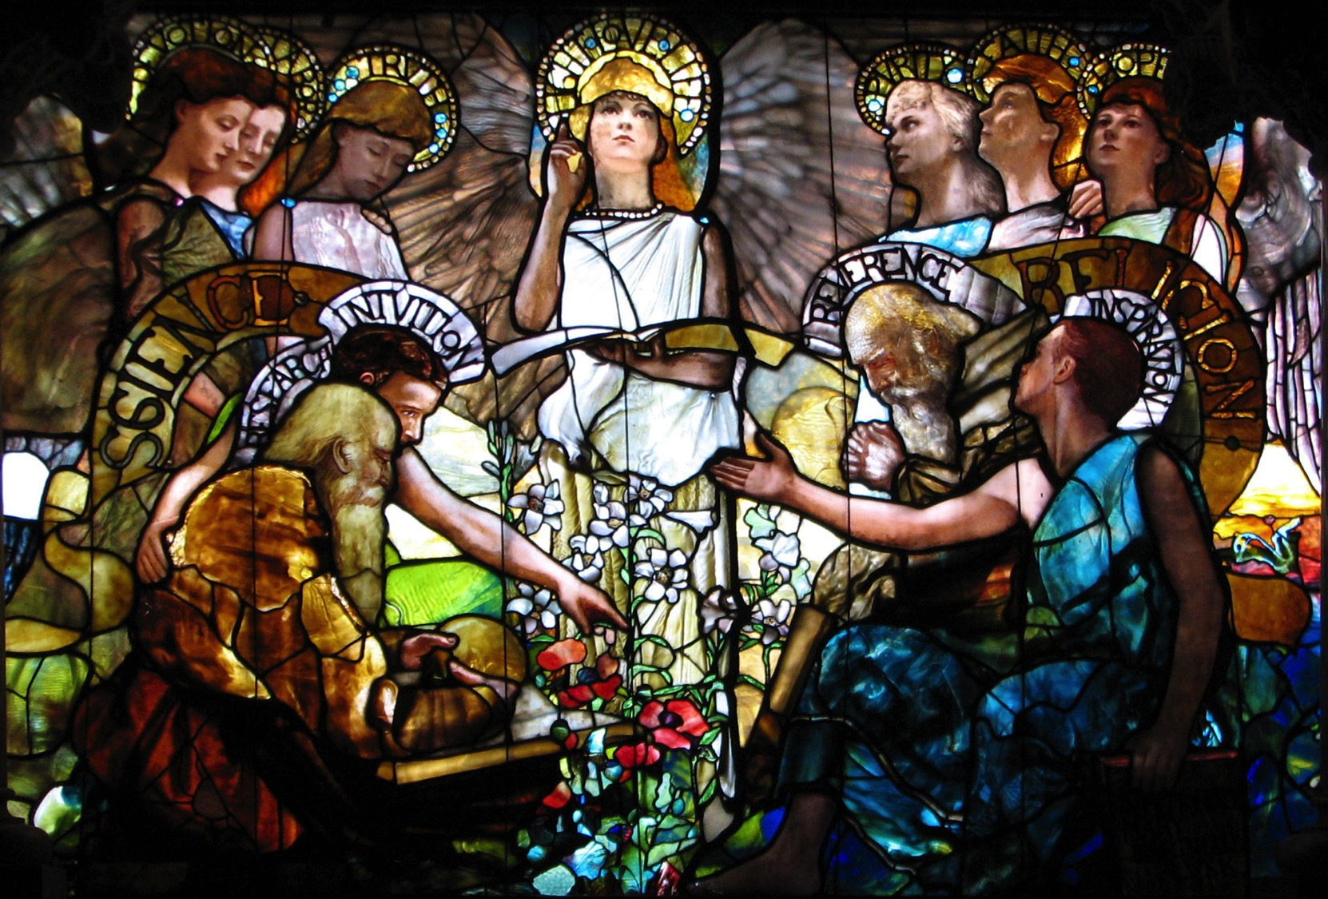

Slide 23
Day 2

Slide 24
Last time (1 of 3):
What’s happening in the world? Astonishing progress; also chaos and instability.
We in the midst of an epochal shift; the “verge of the new”.
The “deeper teachings” of the Bahá’í Faith will play a part. What are they?
For clues, look to past epochal shifts:
The dawn of abstract thought (ca. 100,000 B.C. – “infancy”)
The “Axial Age” and the “two-story” model of reality. (ca. 800-300 B.C. – “childhood”

Slide 25
Last time (2 of 3):
Propose: We in the midst of a “Greater Enlightenment” beginning ca. 1543 and comprising three interlinked stages:
Scientific (“First” Copernican Revolution)
Copernicus
Darwin
Philosophical (“Second Copernican Revolution”)
Kant
Religious (“Third Copernican Revolution”)
The Báb and Bahá’u’lláh
What comprises the heart of the present epochal shift?

Slide 26
Last time (3 of 3):
Conceptual pillars of modern physics
Relativity
Complementarity
Symmetry
Invariance
Some take-aways so far:
The reality one sees is a function of one’s perspective
Behind observed realities lies deep structure and symmetry
Correspondence principle? Foundational concepts in the “physical” and “spiritual” domains map onto each other
Notes:
Symmetry and the Golden Rule

Slide 27
“...the essential reality underlying any given phenomenon is unknown. Phenomenal, or created, things are known to us only by their attributes… the qualities appertaining to this organism [a flower] are perceptible to us, but the intrinsic elemental reality, or identity, of it remains unknown.”
(The Promulgation of Universal Peace, p.421)
'Abdu'l-Bahá
(1844-1921)

Slide 28
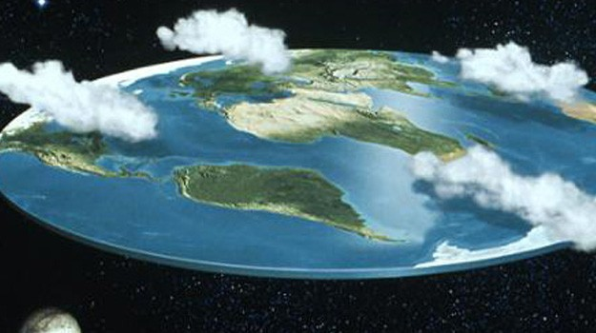
Three levels of approximation

Slide 29
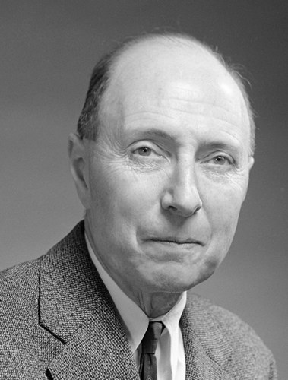
“it is important to point out that the mathematical formulation of the physicist’s often crude experience leads in an uncanny number of cases to an amazingly accurate description of a large class of phenomena.”
Eugene Wigner
(1902-1995)
Notes:
The “unreasonable effectiveness of mathematics” in mapping reality

Slide 30
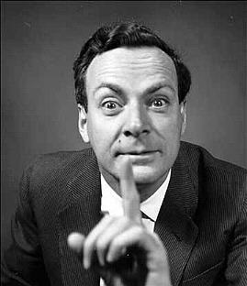
“Finally, and most interesting, philosophically we are completely wrong with the approximate law. Our entire picture of the world has to be altered even though the mass changes only by a little bit. This is a very peculiar thing about the philosophy, or the ideas, behind the laws. Even a very small effect sometimes requires profound changes in our ideas.” (Feynman Lectures in Physics,
vol. 1, pp. 1-2)
Richard Feynman
(1918-1988)
Notes:
An important warning on the value of our mapping systems

Slide 31
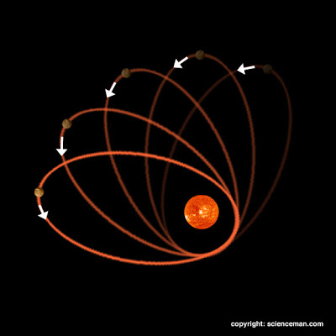
The Perihelion of Mercury

Slide 32
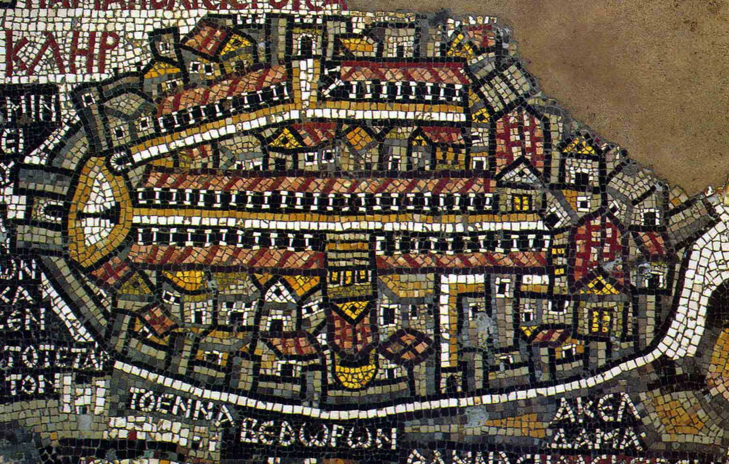
The Madaba Map of Jerusalem (ca. 6th cty A.D.)
Notes:
Our best option: build maps and accept their limitations

Slide 33
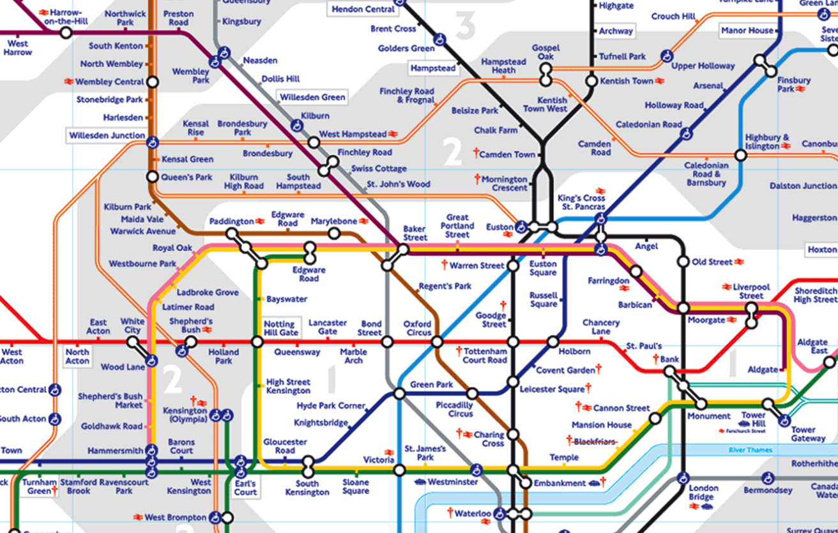
The London Underground

Slide 34
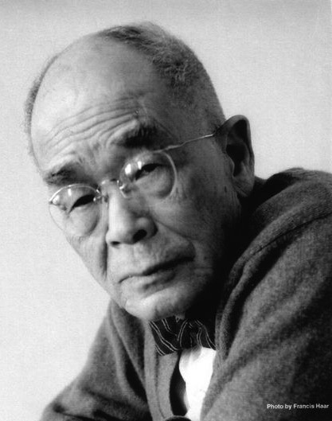
”We humans have the bad habit of giving a name to a certain object with a certain number of attributes, and we think this name exhausts the object thus designated; whereas the object itself has no idea of remaining within the limit prescribed by the name. The object lives, grows, expands, and often changes into something other than the one imprisoned within the name. We who have given the name to it imagine that the object thus named forever remains the same, because, for the practical purposes of life or for the sake of what we call logic, it is convenient to retain the name regardless of whatever changes have taken place and might take place in it. We become a slave to a system of nomenclature we ourselves have invented.”
D.T. Suzuki
(1870-1966)
Notes:
What words, in religion, do we use whose mapping onto reality may be more complex?

Slide 35
“How great the multitude of truths which the garment of words can never contain! How vast the number of such verities as no expression can adequately describe, whose significance can never be unfolded, and to which not even the remotest allusions can be made! How manifold are the truths which must remain unuttered until the appointed time is come! Even as it hath been said: “Not everything that a man knoweth can be disclosed, nor can everything that he can disclose be regarded as timely, nor can every timely utterance be considered as suited to the capacity of those who hear it.” Of these truths some can be disclosed only to the extent of the capacity of the repositories of the light of Our knowledge.” (Gleanings #89)
Bahá’u’lláh
(1817-1892)
Notes:
Inadequacy of words!

Slide 36
“Reveal then Thyself, O Lord, by Thy merciful utterance and the mystery of Thy divine being, that the holy ecstasy of prayer may fill our souls – a prayer that shall rise above words and letters and transcend the murmur of syllables and sounds – that all things may be merged into nothingness before the revelation of Thy splendor.” (Bahá’í Prayers, p. 71)
'Abdu'l-Bahá
(1844-1921)

Slide 37
“The fish trap exists because of the fish; once you've gotten the fish, you can forget the trap. The rabbit snare exists because of the rabbit; once you've gotten the rabbit, you can forget the snare. Words exist because of meaning; once you've gotten the meaning, you can forget the words.”
Chuang Tzu
(ca. 369-286 B.C.)

Slide 38
“O Sun-like Mirrors! Look ye upon the Sun of Truth. Ye, verily, depend upon it, were ye to perceive it. Ye are all as fishes, moving in the waters of the sea, veiling yourselves therefrom, and yet asking what it is on which ye depend.”
(Epistle to the Son of the Wolf, p. 160)
Bahá’u’lláh
(1817-1892)
Notes:
Language is the “ocean” we swim in, without thinking about its existence and limitations

Slide 39
Complementarity
“One might liken Bahá'u'lláh’s teachings to a sphere; there are points poles apart, and in between the thoughts and doctrines that unite them.”
(letter dated 5 Jul. 1947 on behalf of Shoghi Effendi)
Shoghi Effendi
(1897-1957)
Notes:
A consequence of the limits of language and “shifting ground” beneath our feet: “poles”

Slide 40
“There are four schools of thought in the world.... As to the four schools mentioned above, it is clear and evident that the second standeth closer to righteousness (taqvá).... One can, however, provide a justification for the tenets of the other schools, for in a sense all things have been and shall ever remain the manifestations of the names and attributes of God. (The Tabernacle of Unity, #2.6-9)
Bahá’u’lláh
(1817-1892)

Slide 41
“...one person envisages the Unseen, the Transcendent, the Inaccessible One in the Person of the Manifestation without making any distinction or connection between them. Others there are who recognize the Person of the Manifestation as the Appearance of God and consider the commands and prohibitions of the Manifestation to be identical with such as originate with the One True God. These two positions are both acceptable before the throne of God.”
(Lawh-i-Jamál)
Bahá’u’lláh
(1817-1892)

Slide 42
“In this stage, which marketh the beginning of the journey, thou shalt behold divers stations and differing signs, even as was mentioned in connection with the City of Search. All these hold true in their respective planes. It behoveth thine eminence in this station to consider each created thing in its own place, neither abasing nor exalting its true rank. For instance, if thou wert to reduce the unseen world to the realm of creation, this would be an act of sheer blasphemy, and the converse would likewise be the essence of impiety. Wert thou, however, to describe the unseen world and the realm of creation within their own stations, this would be the undoubted truth.... Comprehend, in like manner, every station, sign, and allusion, that thou mayest perceive all things in their own place and consider all matters in their proper light.”
(Gems of Divine Mysteries #88)
Bahá’u’lláh
(1817-1892)

Slide 43
“This one sayeth, ‘Thou art an extremist,’ and the other one sayeth, ‘Thou art intolerant.’ This one adduceth evidence from a word of God, and that one reasoneth by another word of God. But I affirm unto them: Ye both are true and right, on the condition that thou not say unto him, ‘He is an extremist,’ and he not say unto thee, ‘Thou art intolerant.’”
(The Báb, Gate of the Heart pp. 175-176)
The Báb
(1819-1850)

Slide 44
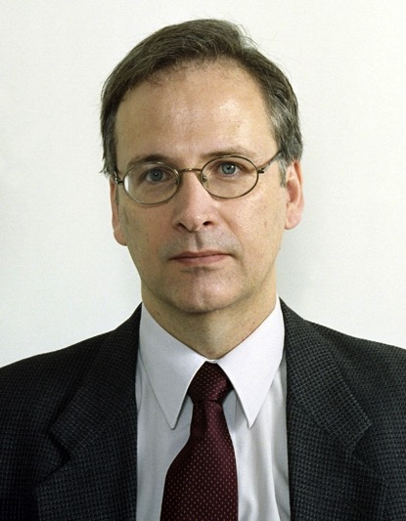
“Without in any way trying to explicitly define the concept of conferred infallibility, consider that the most extreme possible personal interpretations of this concept produce the same practical result: that the believers should abide by the decision of the Universal House of Justice without giving rise to dissension… Even if the statements in the Baha’i Writings about the infallibility of the Universal House of Justice are personally interpreted by an individual to be nothing more than hyperbole, surely the intention must be to emphasize the importance of obedience and the need to avoid criticism and contention and uphold the authority of the Supreme Body as the central point to which all turn.” (Revelation and Social Reality, p. 253)
Paul Lample

Slide 45
The spiritual principles of relativity and complementarity enable the possibility of a spiritual community grounded not upon a fixed set of dogmas but upon a posture of being and acting in the world.

Slide 46
This session
What if theological systems are “maps”? And what if there are complementary “maps” to describe Reality?
Implications for God
Implications for nature
Implications for the soul

Slide 47
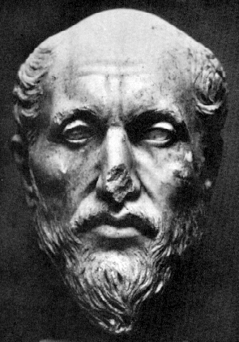
The God beyond number
“…that which is before this Intellect, this marvel of the One, … in truth has no fitting name, but if we must give it a name, ‘one’ would be an appropriate ordinary way of speaking of it... ”
(Ennead VI.9.5)
Plotinus
(240-270)
Plotinus
(1844-1921)

Slide 48
The God beyond number
“The Divine Reality is sanctified from singleness, then how much more from plurality.”
(Some Answered Questions p.113)
'Abdu'l-Bahá
(1844-1921)

Slide 49
The God beyond personality
“Thou hast written concerning the Impersonality of the Divinity. Personality is in the Manifestation of the Divinity, not in the Essence of the Divinity.”
(Tablets of Abdul-Baha Abbas p.204)
'Abdu'l-Bahá
(1844-1921)

Slide 50
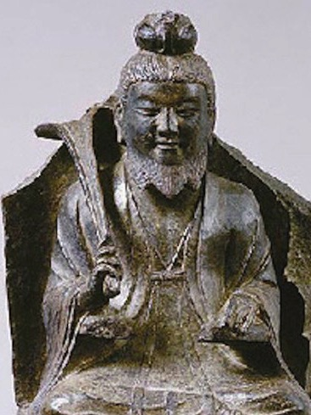
The God beyond attributes
“The way that can be spoken of is not the constant way; The name that can be named is not the constant name.”
(Lao Tzu, Tao te Ching #1)
Lao Tzu
(ca. 530 B.C.)

Slide 51
The God beyond attributes
“I testify that Thou hast been sanctified above all attributes and holy above all names.”
(Bahá’u’lláh, Prayers and Meditations #183)
Bahá’u’lláh
(1817-1892)

Slide 52
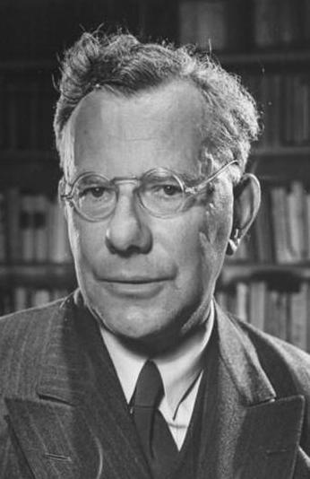
The God beyond existence
“The existence of God can be neither asked nor answered. If asked, it is a question about that which by its very nature is above existence, and therefore the answer—whether negative or affirmative—implicitly denies the nature of God. It is as atheistic to affirm the existence of God as it is to deny it. God is being-itself, not a being.”
(Paul Tillich, Systematic Theology 1:235-237)
Paul Tillich
(1886-1965)

Slide 53
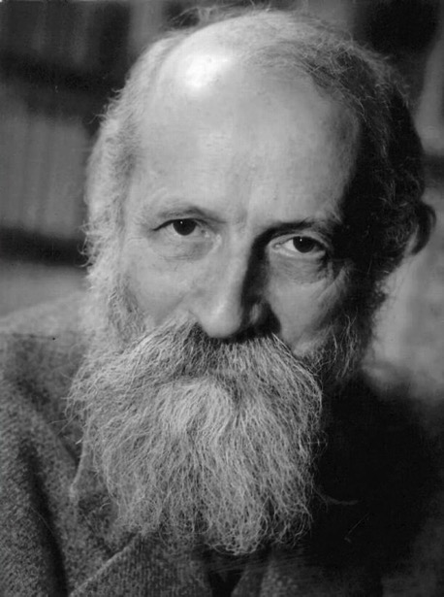
The God beyond object
“When Thou is spoken, the speaker has no thing for his object. For where there is a thing there is another thing. Every It is bounded by others; It exists only through being bounded by others. But when Thou is spoken, there is no thing. Thou has no bounds.”
(Martin Buber, I and Thou)
Martin Buber
(1878-1965)

Slide 54
The God beyond object
“He who worshippeth God through any one but Him, by gazing at his own self as the Worshipper and at God as the Object of his worship, hath joined partners with God and hath never worshipped Him.“
(The Báb, Gate of the Heart pp. 251-252)
The Báb
(1819-1850)

Slide 55
The purpose of the “God-centered” life
“Whatever duty Thou hast prescribed unto Thy servants of extolling to the utmost Thy majesty and glory is but a token of Thy grace unto them, that they may be enabled to ascend unto the station conferred upon their own inmost being, the station of the knowledge of their own selves.”
(Bahá’u’lláh, Gleanings #1)
Bahá’u’lláh
(1817-1892)

Slide 56
God’s “action” = Nature
“Nature is God’s Will and is its expression in and through the contingent world. It is a dispensation of Providence ordained by the Ordainer, the All-Wise. Were anyone to affirm that it is the Will of God as manifested in the world of being, no one should question this assertion.”
(Lawh-i-Hikmat, in Tablets p.142)
Bahá’u’lláh
(1817-1892)

Slide 57
“[Bahá’u’lláh] says that that nature which they regard as the source of all beings is the manifestation of His Creative Name.... It is the First Cause that is the source of all beings and that has been interpreted as nature. The point is this: All the conditions and perfections that the philosophers attribute to nature are the same as have been attributed to the Primal Will in the Holy Scriptures. It is clear that the Primal Will is the manifestation of the Creative Name. (From a commentary on the Tablet of Wisdom, Ma’idiy-i-Asmani, vol. 2, p. 70)
'Abdu'l-Bahá
(1844-1921)

Slide 58
“Therefore it is necessary, according to true wisdom, that the Preexistent God describe Himself to His creatures, that they may recognize their Creator and that, out of the grace of the Pre-existent, the contingent beings may attain their supreme End. This divine self-description is itself a created thing…. Whoso hath recognized it hath recognized his Lord.... This description is denoted as the "soul" or "self", and he who hath known himself hath known his Lord…. Behold with the eye of thy heart. Verily thy truth, the truth of thy being, is the divinity of thy Lord revealed unto thee and through thee. Thou art He Himself, and He is thou thyself, except that indeed thou art that thou art, and He is that He is.” (Gate of the Heart, p.251)
The Báb
(1819-1850)
Notes:
Like Sophie’s world!

Slide 59
“Every time I am reminded of Thee and muse on Thy virtues, I am seized with such ecstasies and am so enravished by Thee that I find myself unable to make mention of Thy name and to extol Thee. I am carried back to such heights that I recognize my self to be the same as the remembrance of Thee in Thy realm, and the essence of Thy praise among Thy servants. As long as that self endureth, so long will Thy praise continue to be shed abroad among Thy creatures and Thy remembrance glorified by Thy people.” (Prayers and Meditations, #78)
Bahá’u’lláh
(1817-1892)

Slide 60
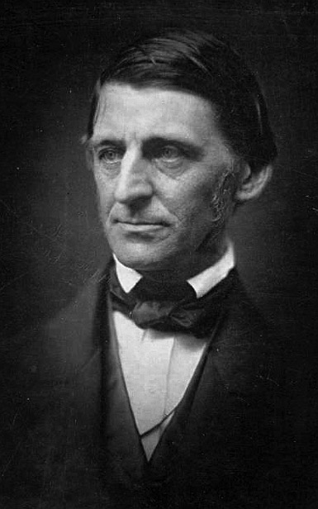
“God screens us evermore from premature ideas. Our eyes are holden that we cannot see things that stare us in the face until the hour comes when the mind is ripened; then we behold them, and the time when we saw them not is like a dream.”
Ralph Waldo Emerson
(1803-1882)

Slide 63
A pragmatic “theology of the dotted line”
The invisible world
The unwritten laws of physics
Metaphysical imponderables: “God”, “soul”, “spirit”
The visible world
Everything that can perceived and measured
The “map making “ activity of science
Religious doctrines, laws and organizations
Spiritual virtues

Slide 65
Day 3

Slide 66
Last time (1 of 2):
Reality can only be approximated
The essence or “thing-in-itself” is unknown
Successive approximations in science: Flat earth vs. spherical vs. warped space-time
An approximation can be almost exactly correct even though its underlying assumptions can be far from reality.
Maps as useful approximations, but which can also be outdated or distorted
Language may not “carve nature at its joints”
Complementary perspectives inevitable: examples in the Bahá’í Writings

Slide 67
Last time (2 of 2):
Theological systems as incomplete maps with “points poles apart”. Some examples of “opposite poles”:
God – as beyond “oneness”, “existence”, and “object of worship”
Nature – as identical to the Primal Will
The soul – as mode of the divine self-description
The “theology of the dotted line” and the spiritual pragmatism of Bahá’u’lláh.
Focus on being and acting in the world, not on dogmatic finalities. Ethic of service and social justice.

Slide 68
Today
The Prophet
Twin stations
“Fruit”
“Physician”
“Educator”
“Vanguard”
“Artist”
Divine Revelation
Interconnectedness
The power of the Word

Slide 69
“Not only in the character of the revelation of Bahá’u’lláh, however stupendous be His claim, does the greatness of this Dispensation reside. For among the distinguishing features of His Faith ranks, as a further evidence of its uniqueness, the fundamental truth that in the person of its Forerunner, the Báb, every follower of Bahá’u’lláh recognizes not merely an inspired annunciator but a direct Manifestation of God.”
(The World Order of Bahá’u’lláh, p.65)
Shoghi Effendi
(1897-1957)

Slide 70
“That He is not to be regarded merely as an inspired Precursor of the Baha'i Revelation, that in His person, as He Himself bears witness in the Persian Bayan, the object of all the Prophets gone before Him has been fulfilled, is a truth which I feel it my duty to demonstrate and emphasize…. There can be no doubt that the claim to the twofold station ordained for the Bab by the Almighty ... constitutes the most distinctive feature of the Bahá'í Dispensation. It is a further evidence of its uniqueness, a tremendous accession to the strength, to the mysterious power and authority with which this holy cycle has been invested.”
(The World Order of Bahá’u’lláh, p.123)
Shoghi Effendi
(1897-1957)

Slide 71
“Nature is subject to a sound organization, to inviolable laws, to a perfect order, and to a consummate design, from which it never departs. To such an extent is this true that were you to gaze with the eye of insight and discernment, you would observe that all things—from the smallest invisible atom to the largest globes in the world of existence, such as the sun or the other great stars and luminous bodies—are most perfectly organized, be it with regard to their order, their composition, their outward form, or their motion, and that all are subject to one universal law from which they never depart.”
(Some Answered Questions, #1)
'Abdu'l-Bahá
(1844-1921)

Slide 72
“If man did not exist, the universe would be without result, for the purpose of existence is the revelation of the divine perfections.… But from the beginning that has no beginning to the end that has no end, a perfect Manifestation has always existed. This Man of Whom we speak here is not just any man: That which we intend is the Perfect Man. For the noblest part of the tree, and the fundamental purpose of its existence, is the fruit. A tree without fruit is of no use.”
(Some Answered Questions, #50)
'Abdu'l-Bahá
(1844-1921)

Slide 74
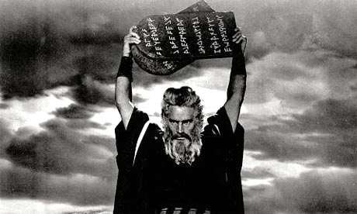

Slide 75
“Say, He Whom God shall make manifest is indeed the Primal Veil of God. Above this Veil ye can find nothing other than God, while beneath it ye can discern all things emanating from God.”
(Selections from the Writings of the Báb, p. 131)
The Báb
(1819-1850)

Slide 76
“Verily the Point possesseth two stations. One is the station that speaketh from God. The other is the station that speaketh from that which is other than God, a station whereby He expresseth His servitude for the former station... He is the possessor of two signs, that of God and that of creation, and through the latter he worshippeth God and boweth in adoration before Him.”
(Gate of the Heart, p. 46)
The Báb
(1819-1850)

Slide 77
“Know verily that whenever this Youth turneth His eyes towards His own self, he findeth it the most insignificant of all creation. When He contemplates, however, the bright effulgences He hath been empowered to manifest, lo, that self is transfigured before Him into a sovereign Potency permeating the essence of all things visible and invisible.”
(Gleanings #49)
Bahá’u’lláh
(1817-1892)

Slide 78
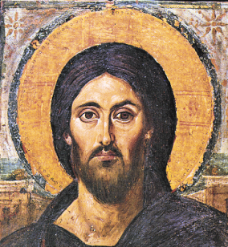
“I am the light which is before all things. It is I who am all things. From me all things came forth, and to me all things extend. Split a piece of wood, and I am there; lift up the stone, and you will find me.”
(The Gospel of Thomas)

Slide 79
“These Manifestations of God have each a twofold station. One is the station of pure abstraction and essential unity.... The other station is the station of distinction, and pertaineth to the world of creation, and to the limitations thereof.”
(Kitab-i-Iqan #161ff)
Bahá’u’lláh
(1817-1892)

Slide 80
“But the universal divine Intellect, which transcends nature, is the outpouring grace of the pre-existent Power. It encompasses all existing realities and receives its share of the lights and mysteries of God. It is an all-knowing power, not a power of investigation and sensing…. This divine intellectual power is confined to the holy Manifestations and the Daysprings of prophethood. A ray of this light falls upon the mirrors of the hearts of the righteous, that they may also receive, through the holy Manifestations, a share and benefit of this power.”
(Some Answered Questions, #58.4)
'Abdu'l-Bahá
(1844-1921)

Slide 81
“The Prophets of God should be regarded as physicians whose task is to foster the well-being of the world and its peoples, that, through the spirit of oneness, they may heal the sickness of a divided humanity.”
(Gleanings #34)
“The All-Knowing Physician hath His finger on the pulse of mankind. He perceiveth the disease, and prescribeth, in His unerring wisdom, the remedy.” (Gleanings #106 and Tabernacle of Unity #1.4
Bahá’u’lláh
(1817-1892)

Slide 82
“...the teachings of Christ and the Prophets are necessary for [man’s] education and guidance. Why? Because They are the divine Gardeners Who till the earth of human hearts and minds. They educate man, uproot the weeds, burn the thorns and remodel the waste places into gardens and orchards....”
(The Promulgation of Universal Peace, p. 295)
'Abdu'l-Bahá
(1844-1921)

Slide 84
“The Holy Divine Manifestations are Unique and Peerless. They are the Archetypes of Celestial and Spiritual Virtues in their own age and cycle. They stand on the Mount of Vision and they foreshadow the perfection of the evolving race.”
(Pilgrim notes of Dr. Fallscheer, 1909-1910)
'Abdu'l-Bahá
(1844-1921)

Slide 85
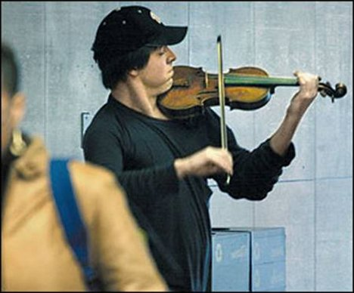
Notes:
The “naturalness” of genius

Slide 86
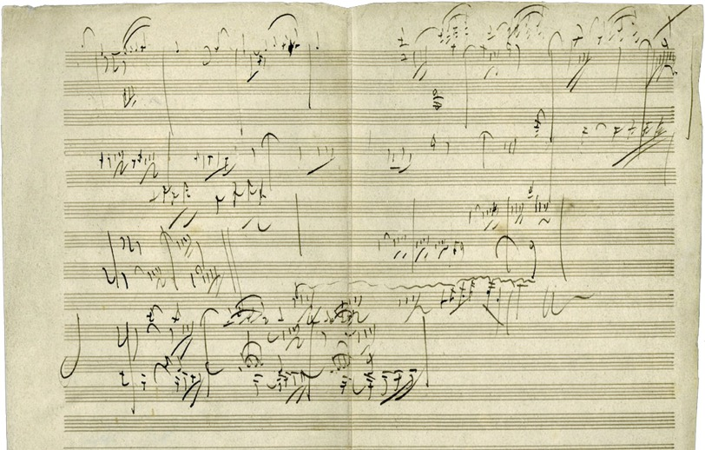
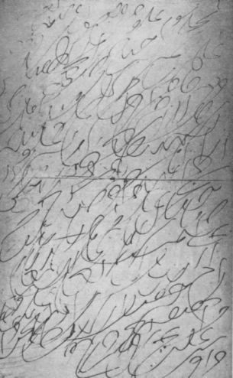
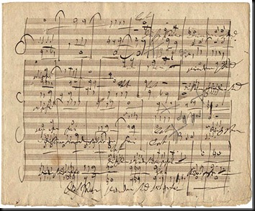
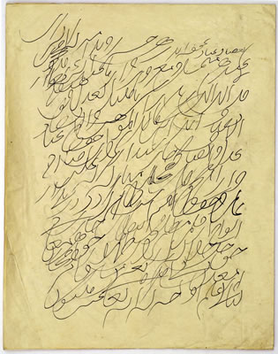
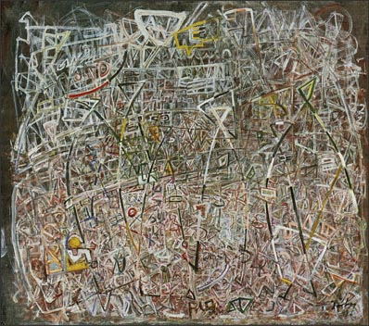

Slide 87
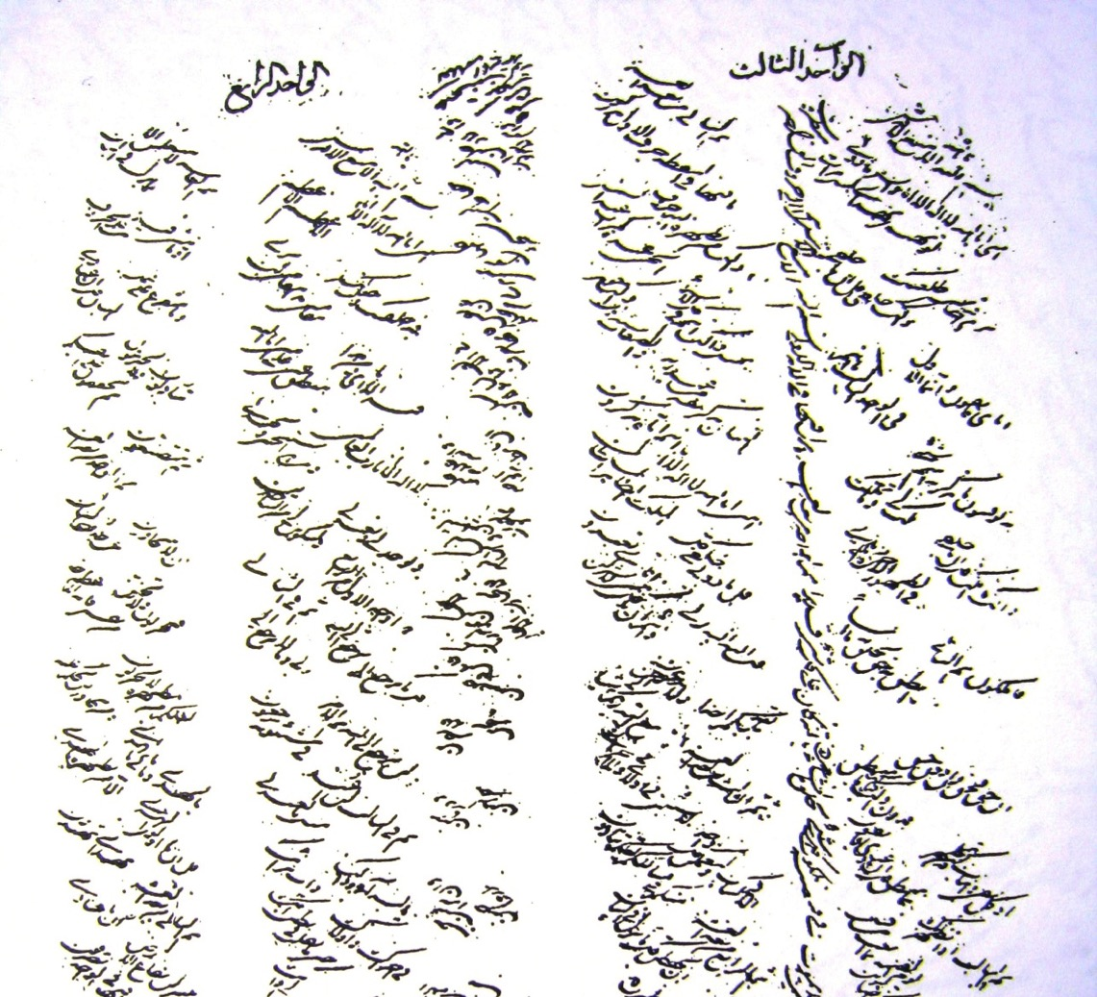
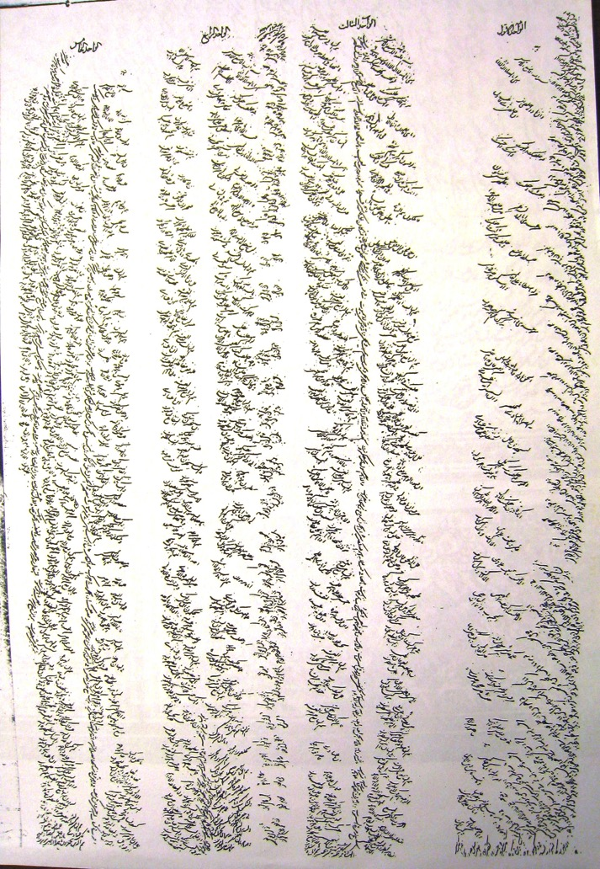

Slide 88
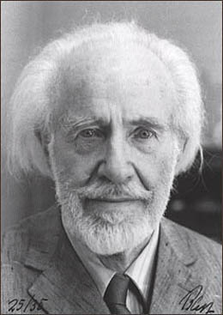
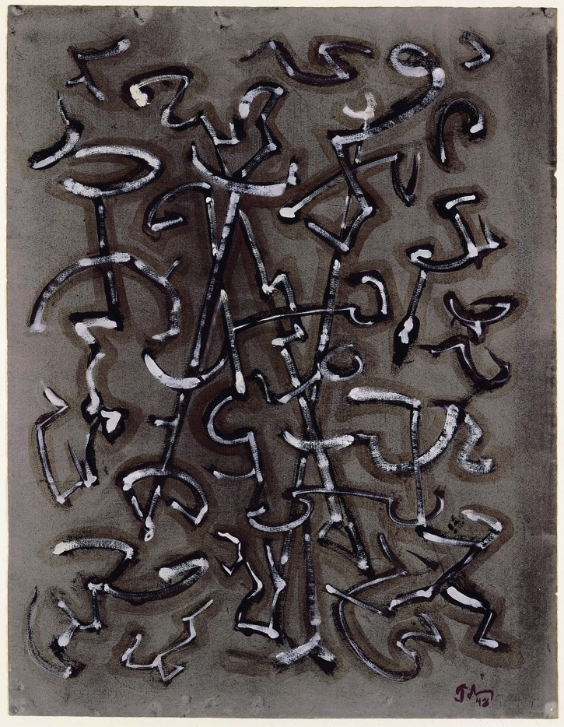
Mark Tobey
(1890-1976)
“White lines in movement symbolize light as a unifying idea which flows through the compartmented units of life bringing a dynamic to men’s minds, ever expanding their energies toward a larger relativity.”

Slide 89
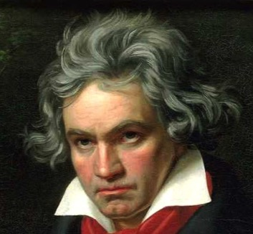
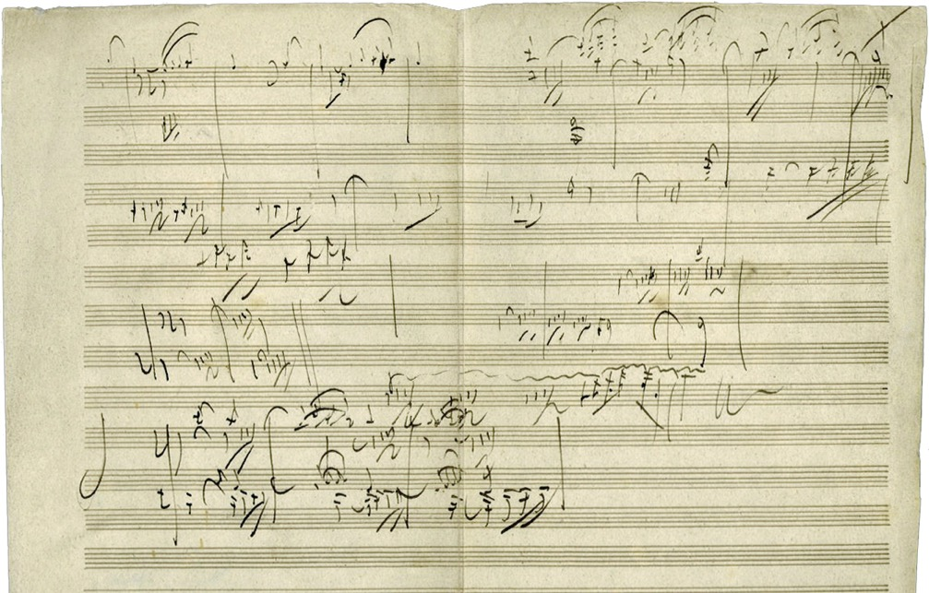
Ludwig van Beethoven (1770-1827)
“Music is the wine which inspires one to new generative processes, and I am Bacchus who presses out this glorious wine for mankind and makes them spiritually drunken.”

Slide 90
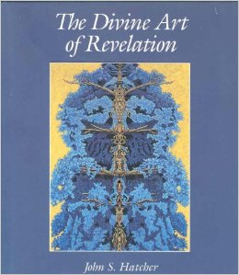
“…both the artist and the Prophet employ essentially the same techniques. Both refrain from coercing us, but, instead, employ devices that require us to become artists ourselves, first by investing a sufficient amount of creative thought to comprehend their ideas, and then by reinvesting that understanding with our own creative action.”
(John Hatcher, “The Divine Art of Revelation”)

Slide 91
“Every religion has brought with it some form of art -- let us see what wonders this Cause is going to bring along. Such a glorious spirit should also give vent to a glorious art. The Temple with all its beauty is only the first ray of an early dawn; even more wondrous things are to be achieved in the future.”
(letter dated 11 December 1931)
Shoghi Effendi
(1897-1957)

Slide 92
“All Art is a gift of the Holy Spirit. When this light shines through the mind of a musician, it manifests itself in beautiful harmonies. Again, shining through the mind of a poet, it is seen in fine poetry and poetic prose. When the Light of the Sun of Truth inspires the mind of a painter, he produces marvellous pictures.”
(The Chosen Highway, p. 167)
'Abdu'l-Bahá
(1844-1921)

Slide 93
“‘Briefly, the supreme Manifestations of God are aware of the reality of the mysteries of beings. Therefore, They establish laws which are suitable and adapted to the state of the world of man, for religion is the essential connection which proceeds from the realities of things.... Religion, then, is the necessary connection which emanates from the reality of things; and as the supreme Manifestations of God are aware of the mysteries of beings, therefore, They understand this essential connection, and by this knowledge establish the Law of God.”
(Some Answered Questions, ch. 41)
'Abdu'l-Bahá
(1844-1921)

Slide 94
“‘Religion, then, is the necessary connection which emanates from the reality of things.” (Some Answered Questions #41)
“By nature is meant those inherent properties and necessary relations derived from the realities of things.” (letter to Dr. Forel)
“Love is the cause of God’s revelation unto man, the vital bond inherent, in accordance with the divine creation, in the realities of things” (Selections from the Writings of Abdu’l-Baha #12)
'Abdu'l-Bahá
(1844-1921)

Slide 95
“These rules and relationships that constitute the basis of human happiness and that attend the descent of the divine favours are none other than the divine law and the social order that ensure the felicity, the integrity and the security of the human race. ...this law and this order consist in the necessary relationships deriving from the realities of things. How could they otherwise bring order to the body politic or be conducive to the well-being and happiness of human society?”
(Siyasiyyih, para. 43, provis. trans.)
'Abdu'l-Bahá
(1844-1921)

Slide 96
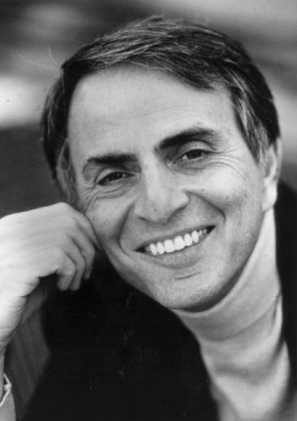
“What an astonishing thing a book is. It's a flat object made from a tree with flexible parts on which are imprinted lots of funny dark squiggles. But one glance and you're inside the mind of another person, perhaps someone dead for thousands of years. Across the millennia, an author is speaking clearly and silently inside your head, directly to you. Writing is perhaps the greatest of human inventions, binding together people who never knew each other, citizens of distant epochs. Books break the shackles of time. A book is proof that humans are capable of working magic.”
Carl Sagan
(1934-1996)

Slide 97
“No breeze can compare with the breezes of Divine Revelation, whilst the Word which is uttered by God shineth and flasheth as the sun amidst the books of men.”
(Epistle to the Son of the Wolf, pp. 42-43)
Bahá’u’lláh
(1817-1892)

Slide 98
“The word which the one true God uttereth in this day, though that word be the most familiar and commonplace of terms, is invested with supreme, with unique distinction.”
(cited in The World Order of Baha’u’llah, p. 104)
Bahá’u’lláh
(1817-1892)

Slide 99
“…it is the Divine Word which is the token and sign of a prophet, the convincing proof to all men and all ages, the everlasting miracle…. the essential characteristic of the Divine Word is the penetrative power (nufudh): it is not spoken in vain, it compels, it constrains, it creates, it rules, it works in men’s hearts, it lives and dies not.”
(words of ‘Andalib, in Eminent Baha’is in the Time of Baha’u’llah, pp. 60-61)

Slide 100
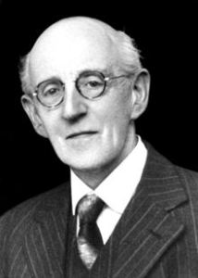
“There is a note, a music, a voice in the Writings of Baha’u’llah, even in translations, which never was heard in English literature before and which has such power that it seems to shake the air as one reads. If other proof were lacking, this Mighty Voice would be proof enough.”
(George Townshend, p. 62)”
George Townshend
(1876-1957)

Slide 101
“The vibrations of Baha’u’llah’s writings are so intense they shiver me with an exaltation and a power I can hardly stand: like standing out in a great storm with the winds roaring and the waves raging and the trees shrieking and crashing and the whole scene uplifting one with its tremendous power and energy and beauty till one is transported and feels part of the titanic drama. I think men will have to develop a lot before they can react rhythmically to Baha’u’llah’s writings: perhaps we are not meant to — the Infinite has come among us nearer than ever before and we are stunned by its Presence.”
(George Townshend, p. 62)
George Townshend
(1876-1957)

Slide 102
“Naught but the celestial potency of the Word of God, which ruleth and transcendeth the realities of all things, is capable of harmonizing the divergent thoughts, sentiments, ideas, and convictions of the children of men. Verily, it is the penetrating power in all things, the mover of souls and the binder and regulator in the world of humanity.”
(Selections #225)
'Abdu'l-Bahá
(1844-1921)

Slide 103
“How strange that while the Beloved is visible as the sun, yet the heedless still hunt after tinsel and base metal. Yea, the intensity of His revelation hath covered Him, and the fullness of His shining forth hath hidden Him.”
(The Seven Valleys, p. 39)
Bahá’u’lláh
(1817-1892)

Slide 104
“It hath been decreed by Us that the Word of God and all the potentialities thereof shall be manifested unto men in strict conformity with such conditions as have been foreordained by Him Who is the All-Knowing, the All-Wise. We have, moreover, ordained that its veil of concealment be none other except its own Self.”
(Gleanings, #33)
Bahá’u’lláh
(1817-1892)

Slide 105
“At one time We spoke in the language of the lawgiver; at another in that of the truth-seeker and the mystic, and yet Our supreme purpose and highest wish hath always been to disclose the glory and sublimity of this station [of love and harmony].”
(Epistle to the Son of the Wolf, p.15)
Bahá’u’lláh
(1817-1892)

Slide 106
Transformative

Slide 107
“The Word is the master key for the whole world, inasmuch as through its potency the doors of the hearts of men, which in reality are the doors of heaven, are unlocked.”
(Tablets of Baha’u’llah, p. 173)
Bahá’u’lláh
(1817-1892)

Slide 108
“...is not the object of every Revelation to effect a transformation in the whole character of mankind, a transformation that shall manifest itself both outwardly and inwardly, that shall affect both its inner life and external conditions? For if the character of mankind be not changed, the futility of God’s universal Manifestation would be apparent.”
(Kitab-i-Iqan #272)
Bahá’u’lláh
(1817-1892)

Slide 110
“All Divine Revelation seems to have been thrown out in flashes. The Prophets never composed treatises. That is why in the Qur'án and our own Writings different subjects are so often included in one Tablet. It pulsates, so to speak. That is why it is ‘Revelation’.”
(8 January 1949 on behalf of Shoghi Effendi, in Unfolding Destiny, p. 454)
Shoghi Effendi
(1897-1957)

Slide 112
Day 4

Slide 113
Last time (1 of 2):
The twin Manifestations of the Baha’i Dispensation
The problem of “Divine Revelation” in the modern world
The nature of the Manifestation
Intermediary between the unseen and visible worlds
Twin stations (unity and distinction; human and divine)
Embodiments of the Universal Divine Mind
As “fruit”; “physician”; “educator”; “visionary”; “artist”
The Prophet as comprehending essential relationships
“Essential relationships” as axis of divine philosophy: unites religion, nature, fate, love, law

Slide 114
Last time (2 of 2):
The nature of the Word of God
The mystical power of words in general
The uniqueness of the revealed Word
The power of the revealed Word
The challenging nature of the Word
Multiple layers of meaning in the Word
The transformative nature of the Word
The scattered nature of the Word and the need for systematic study

Slide 115
“With faces beaming with joy, hasten ye unto Him. This is the changeless Faith of God, eternal in the past, eternal in the future.”
(Kitáb-i-Aqdas #182)
Bahá’u’lláh
(1817-1892)

Slide 117
“Know thou that in every age and cycle, all laws and ordinances have been changed according to the requirements of the times, except the law of love which, like a fountain, ever flows, and whose course never suffers change.”
(The Dawn, v5#12 p.1, translated by Shoghi Effendi)
Bahá’u’lláh
(1817-1892)

Slide 118
“Love is the vital bond inherent, in accordance with the divine creation, in the realities of things. Love is the unique power that bindeth together the diverse elements of this material world, the supreme magnetic force that directeth the movements of the spheres in the celestial realms.”
(Selections from the Writings of Abdu’l-Baha #12)
'Abdu'l-Bahá
(1844-1921)

Slide 119
“The utterance of God is a lamp, whose light is these words: Ye are the fruits of one tree, and the leaves of one branch. Deal ye one with another with the utmost love and harmony, with friendliness and fellowship. He Who is the Day Star of Truth beareth Me witness! So powerful is the light of unity that it can illuminate the whole earth.”
(Gleanings #132)
Bahá’u’lláh
(1817-1892)

Slide 121
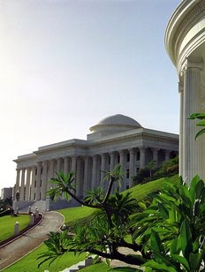
“Bahá’u’lláh has not brought into existence a new religion to stand beside the present multiplicity of sectarian organizations. Rather has He recast the whole conception of religion as the principal force impelling the development of consciousness.”
(One Common Faith, p. 23)
The Universal House of Justice (2005)

Slide 122
“The Navajos have no… word or phrase in their language which could possibly be translated as ‘religion.’ Religion is not a separate entity to be believed in or subscribed to, it is ever present…. Religious rites and practices are an essential element of Navajo culture, pervading it to such an extent that, paradoxical as it may seem, it was several decades before white Americans living among the Navajo realized they possessed any form of worship at all.”
(The Book of the Navajo, p. 45)
Raymond Friday Locke
(1936-2002)

Slide 123
“The Bahá’í message is a call to religious unity and not an invitation to a new religion, not a new path to immortality, God forbid! It is the ancient path cleared of the debris of imaginations and superstitions of men, of the debris of strife and misunderstanding and is again made a clear path to the sincere seeker, that he may enter therein in assurance, and find that the Word of God is one Word, though the Speakers were many.”
(Star of the West, v15#02 p.028)
'Abdu'l-Bahá
(1844-1921)

Slide 124
“...refusing to be labeled as a mere philosophy of life, or as an eclectic code of ethical conduct, or even as a new religion, the Faith of Bahá'u'lláh is now visibly succeeding in demonstrating its claim and title to be regarded as a World Religion, destined to attain, in the fullness of time, the status of a world-embracing Commonwealth… Far from wishing to add to the number of the religious systems, whose conflicting loyalties have for so many generations disturbed the peace of mankind, this Faith is instilling into each of its adherents a new love for, and a genuine appreciation of the unity underlying, the various religions represented within its pale.”
(The World Order of Bahá’u’lláh, pp. 196-197)
Shoghi Effendi
(1897-1957)

Slide 125
“...this Faith is now increasingly demonstrating its right to be recognized, not as one more religious system superimposed on the conflicting creeds which for so many generations have divided mankind and darkened its fortunes, but rather as a restatement of the eternal verities underlying all the religions of the past…”
(statement to the special UN committee on Palestine in 1947)
Shoghi Effendi
(1897-1957)

Slide 126
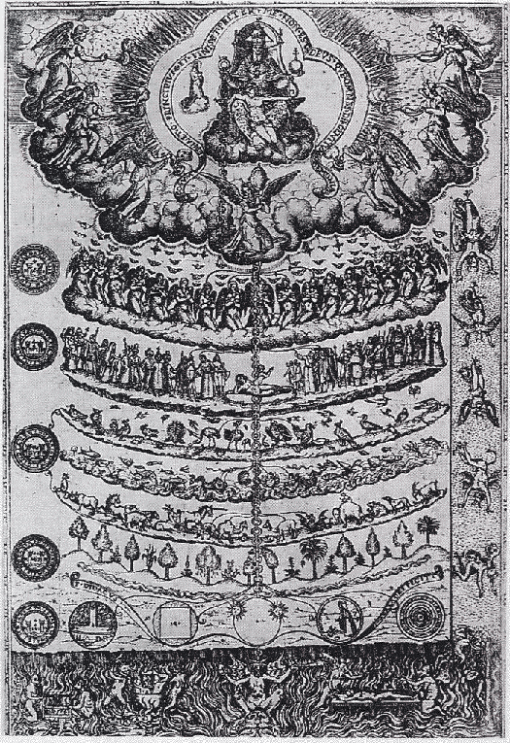

Slide 127
“…all beings are linked together like a chain; and mutual aid, assistance, and interaction are among their intrinsic properties and are the cause of their formation, development, and growth.”
(Some Answered Questions #46.6)
'Abdu'l-Bahá
(1844-1921)

Slide 128
“The chain of creation is interwoven in one universal law and divine order. Everything is interlinked. A link cannot be broken without affecting that universal order. Everything that happens is according to the exigencies of this order and is based on consummate wisdom.”
(Mahmúd’s Diary, 19 Jun. 1912, p. 139)
'Abdu'l-Bahá
(1844-1921)

Slide 129
“This material world has an outward appearance, as it has also an inner reality. All created things are interlinked in a chain leading to spirituality and ultimately ending in abstract realities.”
(Mahmúd’s Diary, 28 Apr. 1912, p. 66)
'Abdu'l-Bahá
(1844-1921)

Slide 130
“…those who have thoroughly investigated the questions of divinity know of a certainty that the material worlds terminate at the end of the arc of descent; that the station of man lies at the end of the arc of descent and the beginning of the arc of ascent, which is opposite the Supreme Centre; and that from the beginning to the end of the arc of ascent the degrees of progress are of a spiritual nature…. The arc of descent ends in material realities and the arc of ascent in spiritual realities. The point of the compass in describing a circle does not reverse its motion, for this would be contrary to the natural movement and the divine order and would disrupt the regularity of the circle.
(Some Answered Questions #81.9)
'Abdu'l-Bahá
(1844-1921)

Slide 132
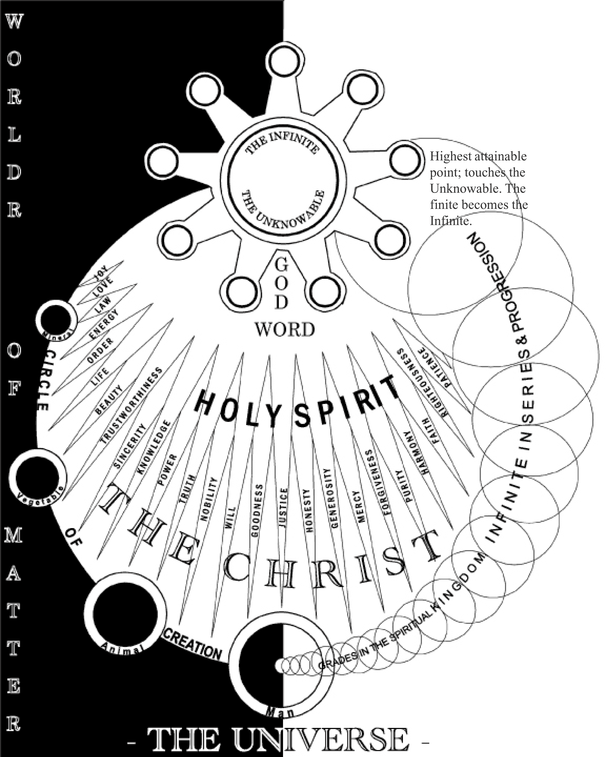

Slide 133
“The dependence of the creatures upon God is a dependence of emanation – that is to say, creatures emanate from God; they do not manifest Him. The relation is that of emanation (sudúr) and not that of manifestation (zuhúr).”
(Some Answered Questions p.202)
'Abdu'l-Bahá
(1844-1921)

Slide 134
“We are a way for the cosmos to know itself”.
Carl Sagan
(1934-1996)

Slide 135
“The deniers ask in their disbelief: ’Where is that world? For that which has no actual material existence is sheer imagination.’ But the truth is that the world of existence is a single world, although its stations are manifold in accordance with the manifold realities of things. For instance, the world of mineral, plant, and animal existence is the same world. Despite this, the animal world in relation to the world of the vegetable is a spiritual reality and another world and abode.”
(Amr va Khalq vol. 1 p. 202 - provis. trans)
'Abdu'l-Bahá
(1844-1921)

Slide 136
“The spiritual world is like unto the phenomenal world. They are the exact counterpart of each other. Whatever objects appear in this world of existence are the outer pictures of the world of heaven.”
(The Promulgation of Universal Peace p. 10)
'Abdu'l-Bahá
(1844-1921)

Slide 137
“Know thou that whatsoever can be found in this mortal world (nasut), this realm of limitation--every name and description, every form and attribute that can be seen or heard--hath, in each world of the worlds of God, manifestations and appearances corresponding to and befitting that world, and appearing with another name, another description, another form and another attribute.”
(Ma’idiy-i-Asmani, vol. 7, p.120 – provis. trans.)
Bahá’u’lláh
(1817-1892)

Slide 138
“The world is but a show, vain and empty, a mere nothing, bearing the semblance of reality. Set not your affections upon it...Verily I say, the world is like the vapor in a desert, which the thirsty dreameth to be water and striveth after it with all his might, until when he cometh unto it, he findeth it to be mere illusion.”
(Gleanings #153)
Bahá’u’lláh
(1817-1892)

Slide 139
“‘Progress’ is the expression of spirit in the world of matter.”
(Paris Talks)
'Abdu'l-Bahá
(1844-1921)

Slide 140
“There is no contradiction between true religion and science. When a religion is opposed to science it becomes mere superstition.... The true principles of all religions are in conformity with the teachings of science.”
(Paris Talks #44:2-3)
'Abdu'l-Bahá
(1844-1921)

Slide 141
“Were one to observe matters with but scant attention, the rank and station of every soul could be plainly read from his conduct and bearing…. Wert thou to consider the motion and stillness, the merits and attainments, the exaltation and abasement of the souls and to examine their conduct and bearing, the inner reality of every soul would become clear and evident and no need would remain for any further proof or evidence.”
(Lawh-i-’Ammih, provis. trans.)
'Abdu'l-Bahá
(1844-1921)

Slide 142
“There is but one reality and one essence that is expounded in the worlds of outer form, and, at each of its stages, is described by a specific name ... in accordance with the degrees of its particular manifestations on the plane of this limited world.”
(cited in "A Bahá'í Perspective on the Origin of Matter", Journal of Baha’i Studies 2:3 p.41-42 – provis. trans.)
Bahá’u’lláh
(1817-1892)

Slide 143
“The essence of existence is a spiritual reality because invisible forces of the spirit are the origin of matter and the foundation thereof.”
(translation from a letter in Persian)
Shoghi Effendi
(1897-1957)

Slide 144
“After passing through the Valley of knowledge, which is the last plane of limitation, the wayfarer cometh to the Valley of Unity, and drinketh from the cup of the Absolute, and gazeth on the Manifestations of Oneness. In this station he pierceth the veils of plurality, fleeth from the worlds of the flesh, and ascendeth into the heaven of singleness…. He stretcheth out the hand of truth from the sleeve of the Absolute; he revealeth the secrets of power. He seeth in himself neither name nor fame nor rank, but findeth his own praise in praising God. He beholdeth in his own name the name of God; to him, “all songs are from the King,” and every melody from Him…. He looketh on all things with the eye of oneness, and seeth the brilliant rays of the divine sun shining from the dawning-point of Essence alike on all created things, and the lights of singleness reflected over all creation.”
(The Seven Valleys)
Bahá’u’lláh
(1817-1892)

Slide 146
Not used:

Slide 147
“Having recognized thy powerlessness to attain to an adequate understanding of that Reality which abideth within thee, thou wilt readily admit the futility of such efforts … to fathom the mystery of the Living God…. This confession of helplessness which mature contemplation must eventually impel every mind to make is in itself the acme of human understanding, and marketh the culmination of man's development.”
(Bahá’u’lláh, Gleanings #83)
Bahá’u’lláh
(1817-1892)

Slide 148
“...the wisdom of God necessitates diversity and distinction in the earning of livelihood. If there were no diversity there would be no order in affairs and no perfection in existence.” (provis. trans., Makatib-i-Abdu’l-Baha vol. 1)
'Abdu'l-Bahá
(1844-1921)

Slide 149
“Say: Rejoice not in the things ye possess; tonight they are yours, tomorrow others will possess them.... Can ye claim that what ye own is lasting or secure? Nay! By Myself, the All-Merciful. The days of your life flee away as a breath of wind, and all your pomp and glory shall be folded up as were the pomp and glory of those gone before you…. What advantage is there in the earthly things which men possess? That which shall profit them, they have utterly neglected.”
(Kitáb-i-Aqdas #40)
Bahá’u’lláh
(1817-1892)

Slide 150
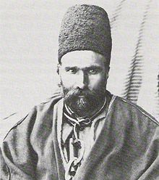
“Once Varqá asked Bahá'u'lláh, 'How will the Cause of God be universally adopted by mankind?' Bahá'u'lláh said that first, the nations of the world would arm themselves with infernal engines of war, and when fully armed would attack each other like bloodthirsty beasts. As a result, there would be enormous bloodshed throughout the world. Then the wise from all nations would gather together to investigate the cause of such bloodshed. They would come to the conclusion that prejudices were the cause, a major form being religious prejudice. They would therefore try to eliminate religion so as to eliminate prejudice. Later they would realize that man cannot live without religion. Then they would study the teachings of all religions to see which of the religions conformed to the prevailing conditions of the time. It is then that the Cause of God would become universal.”
(The Revelation of Bahá'u'lláh, vol.4, p.56; original Persian in Misábih-i-Hidáyat, vol.1, p.263)
Mirza Ali Muhammad, “Varqá”
(1855-1896)

Slide 151
“The inordinate disparity between rich and poor, a source of acute suffering, keeps the world in a state of instability, virtually on the brink of war. Few societies have dealt effectively with this situation…. It is an issue that is bound up not only with the necessity for eliminating extremes of wealth and poverty but also with those spiritual verities the understanding of which can produce a new universal attitude. Fostering such an attitude is itself a major part of the solution.”
("The Promise of World Peace", Oct. 1985)
The Universal House of Justice

Slide 152
Question: Could not the Bahá'í Movement be furthered by use of socialist and labor union movements?
“All nations must become socialistic in spirit. People must not be forced by circumstances to help the poor. They must give aid willingly. That which the socialists aim to accomplish in the economic world will in time be done by the people freely through faith and love and cooperation. For that which is established through loving friendship is permanent.
(Talk given in Washington D.C., 22 Apr. 1912, Barstow collection #336B)
'Abdu'l-Bahá
(1844-1921)

Slide 153
“To state the matter briefly, the Teachings of Bahá’u’lláh advocate voluntary sharing, and this is a greater thing than the equalization of wealth. For equalization must be imposed from without, while sharing is a matter of free choice. ...voluntary sharing, the freely-chosen expending of one’s substance, leadeth to society’s comfort and peace. It lighteth up the world; it bestoweth honour upon humankind.”
(Selections from the Writings of Abdu’l-Baha #79)
'Abdu'l-Bahá
(1844-1921)

Slide 154
“And among the teachings of Bahá’u’lláh is voluntary sharing of one’s property with others among mankind. This voluntary sharing is greater than equality, and consists in this, that man should not prefer himself to others, but rather should sacrifice his life and property for others. But this should not be introduced by coercion so that it becomes a law and man is compelled to follow it. Nay, rather, man should voluntarily and of his own choice sacrifice his property and life for others, and spend willingly for the poor, just as is done in Persia among the Bahá’ís.”
(Selections from the Writings of Abdu’l-Baha #227)
'Abdu'l-Bahá
(1844-1921)

Slide 155
“Hearts must be so cemented together, love must become so dominant that the rich shall most willingly extend assistance to the poor and take steps to establish these economic adjustments permanently. If it is accomplished in this way, it will be most praiseworthy because then it will be for the sake of God and in the pathway of His service. For example, it will be as if the rich inhabitants of a city should say, “It is neither just nor lawful that we should possess great wealth while there is abject poverty in this community,” and then willingly give their wealth to the poor, retaining only as much as will enable them to live comfortably.”
(The Promulgation of Universal Peace, p.238)
'Abdu'l-Bahá
(1844-1921)

Slide 156
“And among the teachings of Bahá’u’lláh is voluntary sharing of one’s property with others among mankind. This voluntary sharing is greater than equality, and consists in this, that man should not prefer himself to others, but rather should sacrifice his life and property for others. But this should not be introduced by coercion so that it becomes a law and man is compelled to follow it. Nay, rather, man should voluntarily and of his own choice sacrifice his property and life for others, and spend willingly for the poor, just as is done in Persia among the Bahá’ís.”
(Foundations of World Unity, pp. 43-44)
'Abdu'l-Bahá
(1844-1921)

Slide 157
“For although at the present time the rich enjoy the greatest luxury and comfort, they are nevertheless deprived of eternal happiness; for eternal happiness is contingent upon giving, and the poor are everywhere in the state of abject need.”
(The Promulgation of Universal Peace, p.132)
'Abdu'l-Bahá
(1844-1921)

Slide 158
“This, however, is but the beginning of the dawn, and the heat of the rising Orb of Truth is not yet at the fullness of its power. Once the sun hath mounted to high noon, its fires will burn so hot as to stir even the creeping things beneath the earth; and although it is not for them to behold the light, yet will they all be set in frenzied motion by the impact of the heat.”
(Selections from the Writings of Abdu'l-Bahá, #16 )
'Abdu'l-Bahá
(1844-1921)

Slide 159
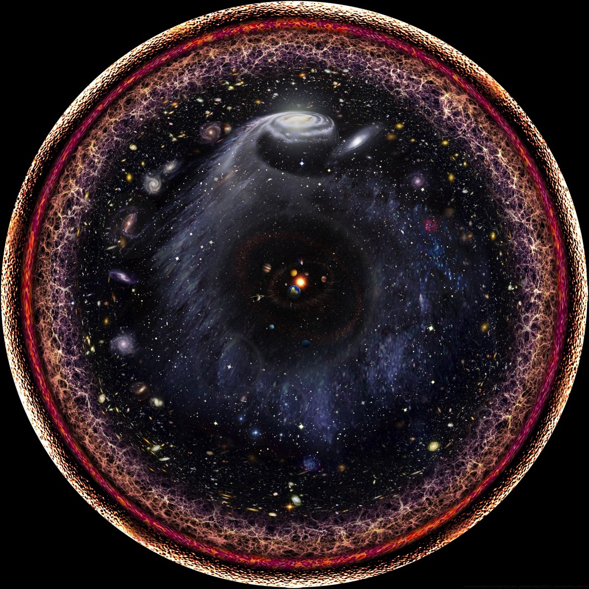

Slide 160
Ahadiyyih
(undifferentiated oneness)
GOD
“I was a Hidden Treasure.”
Háhút
The “cloud”
The “uncompounded reality”
Fayd-i-Aqdas
(Most Holy Outpouring)
The primal veil
Láhút
Wáhidiyyih
(derived oneness)
COMMAND
“I loved to be known;”
The Logos; the Manifestation
The Holy Spirit
“eternal archetypes”
Jabarút
Primal Will (mashiyyat)
Purpose (irádih)
Predestination (qadar)
Fayd-i-Muqaddas
(Holy Outpouring)
Fate (qadá)
Permission (idhn)
Fixed Time (ajal)
The Book (kitáb)
“…that I might
become known.”
Arc of ascent
Arc of descent
“therefore I brought
creation into being…”
Malakút
Heaven
Násút
Earth
Mineral spirit
Spirit of faith
Vegetable spirit
Tajalliy-i-’Amm
(universal revelation)
CREATION
Animal spirit
Human spirit

Slide 161
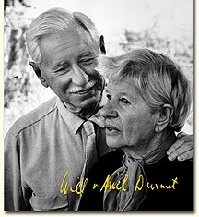
“In religion the mature mind has passed through three stages: belief, unbelief, and understanding.”
(The Story of Civilization, vol. IX)
Will and Ariel Durant
(1803-1882)

Slide 162
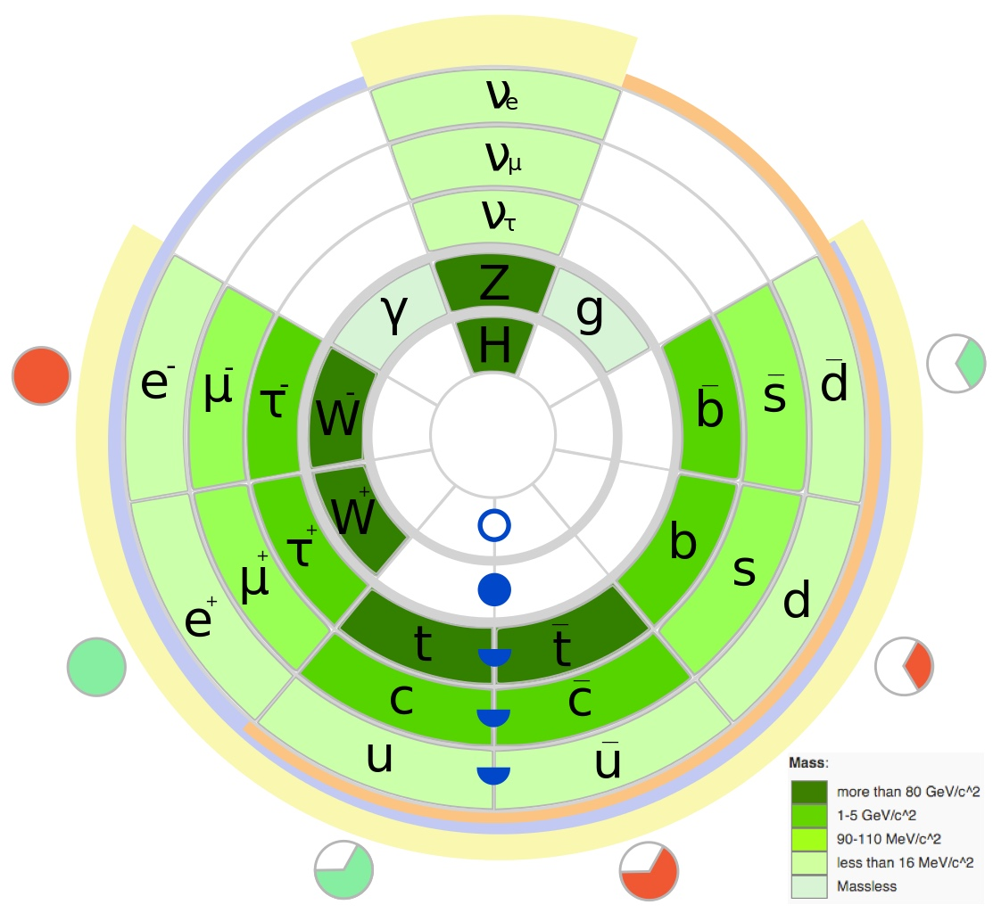

Slide 163
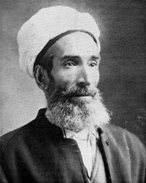
“First it must be recognized that philosophers and researchers in the scholarly community have defined "spirit" in different ways. The best, most perfect, and clearest of these is that spirit is an abstract substance separate from matter in essence but not in act. It will not be hidden from the wise that this definition, insofar as it is a definition by negation, fails to elucidate the reality of the essence of the thing described. It is a comprehensive, restrictive definition which, nonetheless, better explains the intent of the word "spirit" than other definitions.”
‘Mírzá Abu'l-Fadl
(1844-1914)

Slide 164
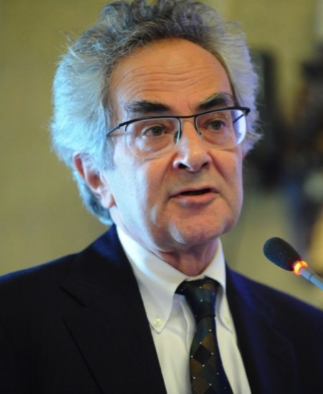
“The teleological hypothesis is that [value] may be determined not merely by value-free chemistry and physics but also by something else, namely a cosmic predisposition to the formation of life, consciousness, and the value that is inseparable from them….
“Some form of natural teleology … would be an alternative to a miracle—either in the sense of a wildly improbable fluke or in the sense of a divine intervention in the natural order. The tendency for life to form may be a basic feature of the natural order, not explained by the nonteleological laws of physics and chemistry.” (Mind and Cosmos, pp. 122-124)
Thomas Nagel
(1937- )

Slide 165
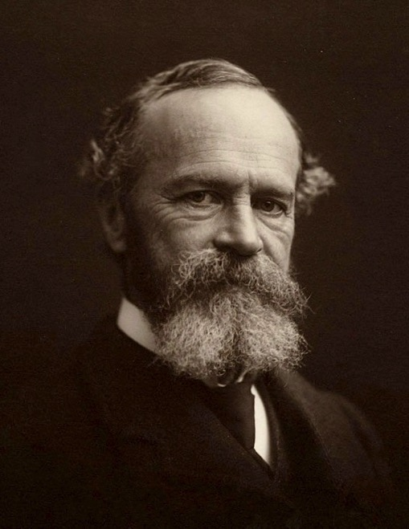
“This absolute determinability of our mind by abstractions is one of the cardinal facts in our human constitution. Polarizing and magnetizing us as they do, we turn towards them and from them, we seek them, hold them, hate them, bless them, just as if they were so many concrete beings. And beings they are, beings as real in the realm which they inhabit as the changing things of sense are in the realm of space. “Plato gave so brilliant and impressive a defense of this common human feeling, that the doctrine of the reality of abstract objects has been known as the platonic theory of ideas ever since.” (The Varieties of Religious Experience, pp. 54-57)
William James
(1842-1910)

Slide 166
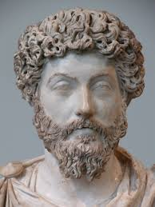
“So where should a man direct his endeavor? Here only – a right mind, action for the common good, speech incapable of lies, a disposition to welcome all that happens as necessary, intelligible, flowing from an equally intelligible spring of origin.” (Meditations IV:33)
“Let one thing be your joy and comfort: to move on from social act to social act, with your mind on God.” (Meditations VI:7)
“In this world there is only one thing of value, to live out your life in truth and justice, tolerant of those who are neither true nor just.” (Meditations VI:47)
Marcus Aurelius
(Roman emperor, 121-180 A.D.)

Slide 167
